Slide 1

Impact of Tariffs, Inflation, and Economic Indicators
on U.S. Beverage Imports
Mauri Murray, Julie O’Keefe, Payton Swart, and Sarah Whiting

Slide 2
TABLE OF CONTENTS
01
04
02
05
03
06
Business Problem
Results & Evaluation
Data Overview
Business Implications
Modeling Approach
Conclusion

Slide 3

01
Business
Problem

Slide 4
U.S. Beverage Import Dependency and Price Volatility
The U.S. relies heavily on beverage imports (wine, beer, liquors, non-alcoholic drinks) to meet domestic demand.
Global trade shifts, economic changes, and tariff adjustments directly influence the price of these imports.
Accurate 2025 pricing forecasts are essential for:
  Budgeting and pricing strategies
  Inventory decisions
  Risk management and trade policy alignment
Notes:
The United States has a significant reliance on imported beverages to meet domestic consumption. Domestic production alone isn’t enough to satisfy consumer demand, so imports fill the gap.
However, this dependence makes the U.S. beverage market extremely vulnerable to changes in the global trade landscape. Factors like economic shifts, international supply chain disruptions, and especially changes in tariff policies can cause substantial price fluctuations.When tariffs go up the cost is often passed along to consumers. But it also affects business operations.
So the problem we’re focusing on is this: Without accurate forecasting of 2025 import prices and correlation between GDP and inflation, companies operating in the U.S. beverage industry risk making uninformed decisions. These might include setting uncompetitive prices, overstocking or understocking inventory, or entering into unfavorable contracts.

Slide 5
Why Accurate Forecasting Matters
Distributors & Importers: Forecast costs to negotiate contracts and protect profit margins.
Trade Authorities & Policy Makers: Assess tariff impacts to maintain market stability.
Investors & Analysts: Identify trade-related investment risks.
Retailers: Prepare for price shifts and adjust pricing strategies.
Supply Chain Managers: Develop resilient sourcing and logistics strategies.
Notes:
First, distributors and importers are directly impacted. They’re the ones purchasing large volumes of beverages, often across borders, and they need to forecast future import costs to negotiate both long-term and short-term contracts. Accurate forecasts can protect their profit margins and give them leverage in pricing discussions with suppliers and buyers.
Trade authorities and policy makers are individuals and organizations tasked with crafting and adjusting tariff policies. They need accurate pricing models to understand the impact of those tariffs on market stability, on consumer pricing, and on the broader economic picture. Their decisions can either protect or destabilize markets.
Next, we have investors and financial analysts. For them, beverage import trends are not just about pricing—they’re also about risk. Global trade volatility, driven by economic uncertainty or policy shifts, introduces investment risk. Understanding the dynamics of import pricing helps analysts and investors gauge potential vulnerabilities in supply chains and allocate capital wisely.
Then there’s retailers—especially large grocery chains and liquor store franchises. These companies compete in an extremely price-sensitive environment. Forecasting helps them anticipate cost increases and plan promotional pricing strategies accordingly, keeping their margins healthy without alienating consumers.
Finally, supply chain managers play a key strategic role. They rely on pricing forecasts to manage supplier relationships, avoid over-reliance on a single source, and develop contingency plans. With volatile pricing, having a diversified and responsive supply chain becomes a competitive advantage.

Slide 6
Leveraging Data for Strategic Decisions
Use historical data (1999–2024) on prices, GDP, tariffs for insights.
Data mining identifies:
  Correlations between prices, tariffs, and economic indicators
  Patterns in cost, demand, and volume
Outcomes:
  Predict effects of trade policies
  Optimize import strategies
  Expand profitable market segments
Notes:
By leveraging historical import price data from 1999 through 2024, along with macroeconomic indicators like GDP and tariff rates, businesses can uncover deep insights into how these variables interact over time.
Data mining enables us to identify correlations between price increases and specific economic events or policy changes. It can also highlight seasonal or cyclical trends in beverage import volumes, or show how particular tariffs impacted pricing across different beverage categories.
For example, a company could analyze how rising tariffs on European wine impacted sales volumes and pricing in previous years, and use that model to project what might happen under proposed new tariffs. Similarly, by comparing import prices with GDP trends, companies can understand how consumer purchasing power may affect demand for premium versus value brands.
This type of analysis empowers businesses to be proactive instead of reactive. Rather than scrambling to adjust to sudden price increases or shortages, they can build flexible pricing models, negotiate smarter contracts, and design agile supply chain strategies.
In the long term, using data to inform decisions doesn’t just solve the current problem—it builds a culture of resilience and adaptability that can weather future market shifts.

Slide 7

02
Data Overview

Slide 8
Data Source
The data originates from the U.S. Food Imports dataset, published by the U.S. Department of Agriculture’s Economic Research
Overview of annual import values of food and beverages imported through U.S. ports and listed their countries of origin
Contains annual records from 1999 to 2024 (26 years) and includes variables related to beverage consumption, economic indicators, and trade tariffs in the United States.
No missing values, consists of 26 rows, nine columns with eight features and one time indicator.
All columns are numeric, either integer or float with no categorical or text features

Slide 9
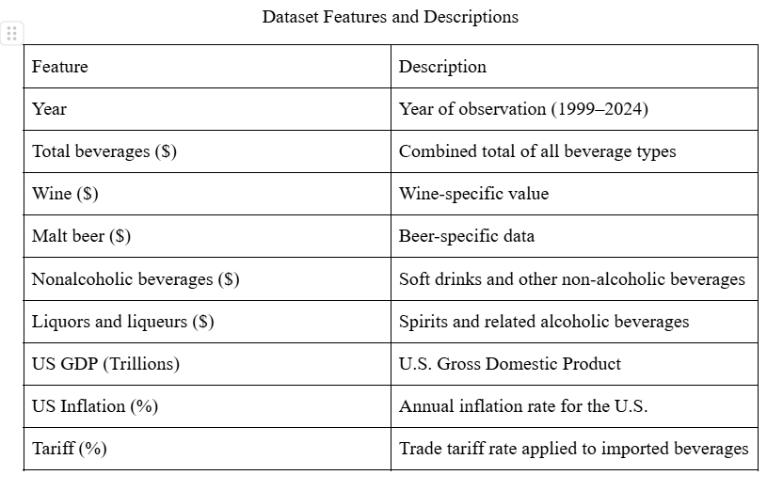

Slide 10

03
Modeling Approach

Slide 11
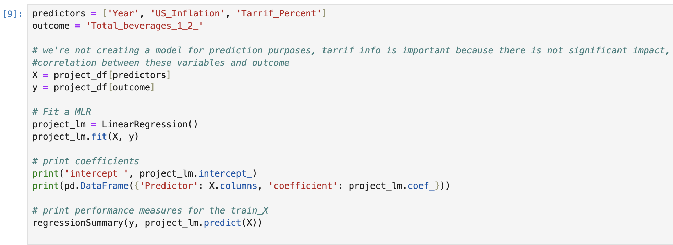
MLR Modeling Approach
Notes:
The model we built first was an MLR model, which is a statistical technique that uses several explanatory variables to predict the outcome of a response variable. The goal of this model is to show the linear relationship between independent variables and a dependent variable. In this model, our predictors or independent variables are Year, US Inflation, and Tariff Percent. Our outcome variable or dependent variable is Total Beverages, which is the import price for wine, malt beer, nonalcoholic beverages, liquors and liqueurs all combined. The advantages of using this model is that we are able to determine the relative influence of one or more predictor variables on the outcome variable and the ability to identify outliers. The disadvantages of using this model is that statistical significance doesn’t guarantee good predictive performance for future outcomes. This model ultimately just indicates positive or negative relationships between variables and the rest of the conclusions are just assumptions. we cleaned the data in this specific machine learning model by replacing the spaces in the column heading with underscores and also replacing the slashes in the column headings with underscores. This simply allowed for efficiency throughout the coding process. Luckily our data was fairly specific for our needs so we did not have to deal with any missing values or outliers. In the MLR we did not have to partition the data into training and testing models because the point of this model was not to create it for prediction purposes. The point of this model was instead to confirm our thoughts on if Inflation, Year, and Tariff Percent actually affect the Total Beverage import price amount. Some of the other steps we took in the preprocessing step of modeling was checking on the assumptions of multiple linear regression.

Slide 12
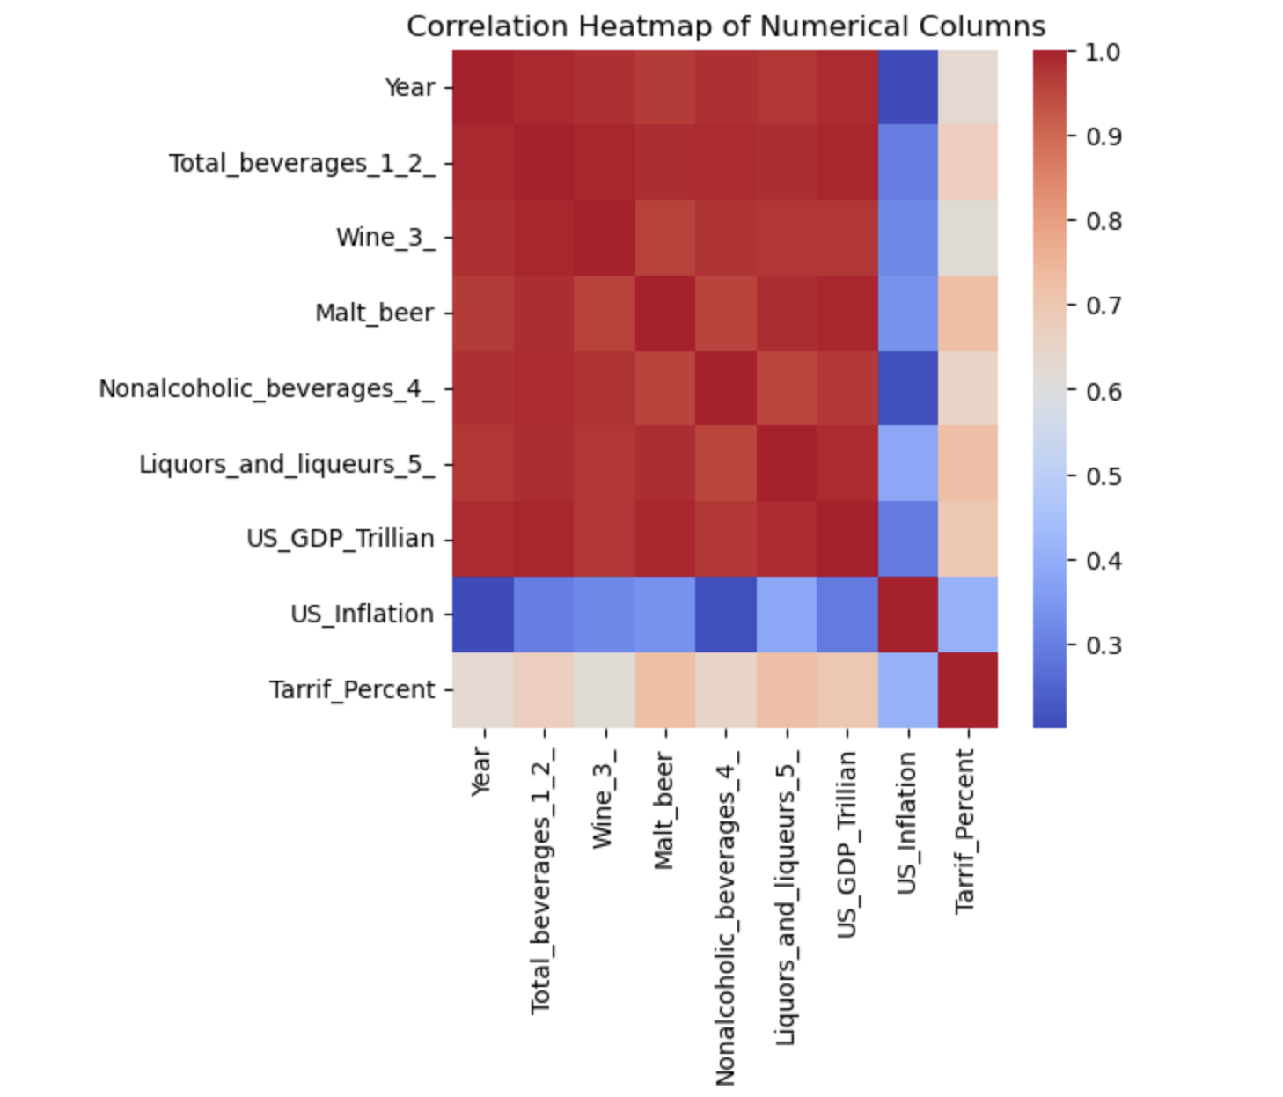
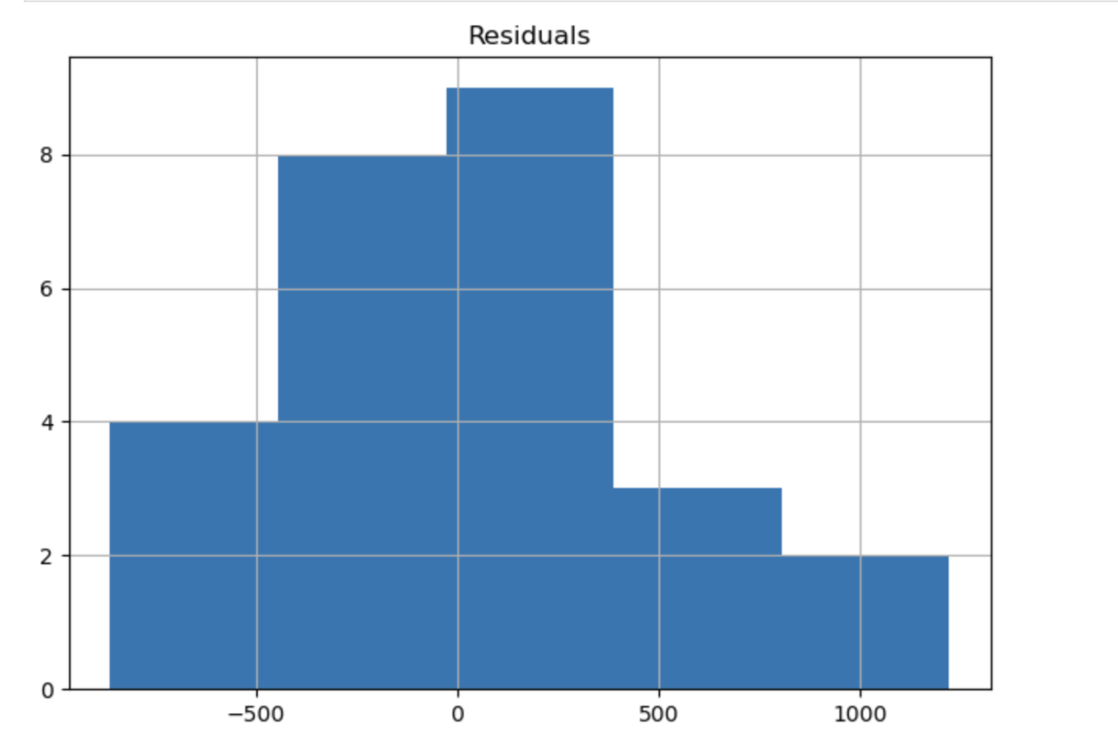
MLR Modeling Approach
Check for MLR Assumptions
Notes:
In this process we checked for homoscedasticity, normality, and no multicollinearity.In our Correlation Heatmap of Numerical Columns, Year, Total Beverages, Wine, Malt Beer, Nonalcoholic Beverages, Liquors and Liqueurs and US GDP Trillion were all highly correlated. Multicollinearity which occurs when two or more independent variables are highly correlated, can inflate standard errors and make coefficient estimates unreliable. This was insightful because we were able to pick the dependent variables that were not as much associated with one another to use in our analysis, which were US Inflation Tariff Percent, and Year. It is important to note that Year and Total Beverages were highly correlated but because Total Beverages was the dependent variable and Year was one of the independent variables, this rule was not broken and we were able to continue further with our analysis. The histogram helped us check for Normality and because the data is a normal distribution, this chart helps us check that box.

Slide 13
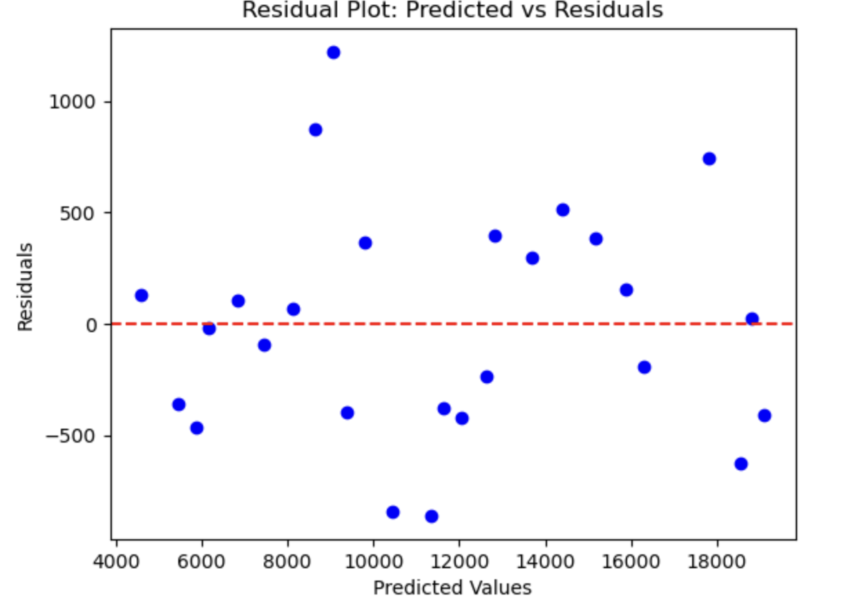
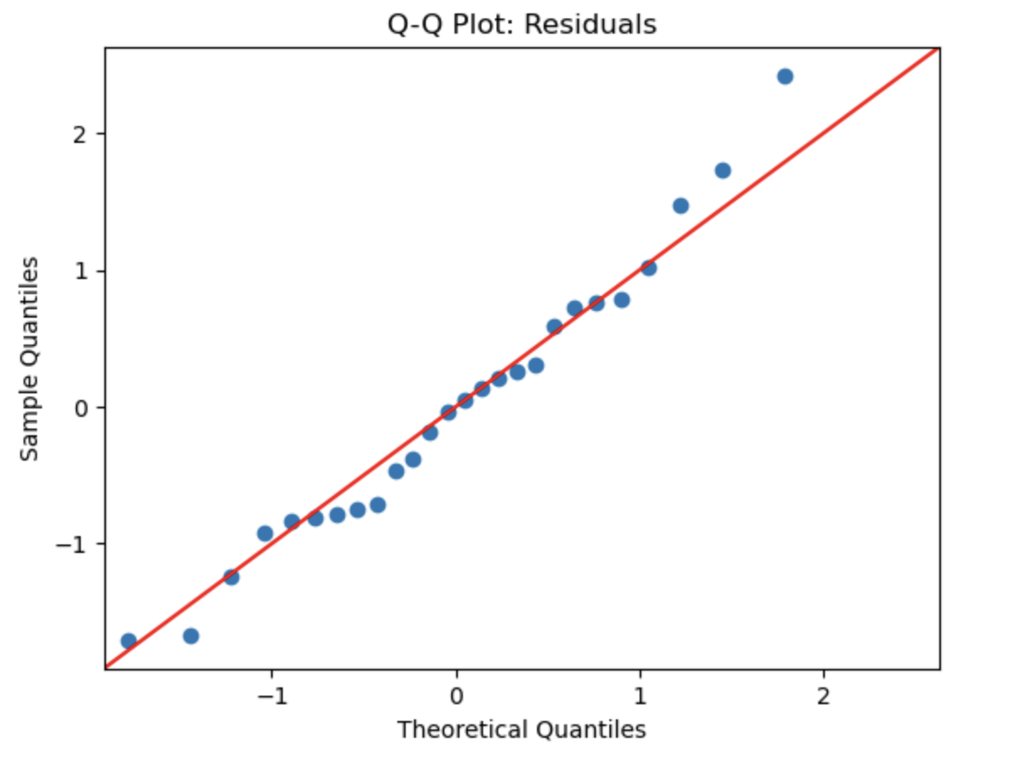
MLR Modeling Approach
Check for MLR Assumptions
Notes:
In our Residual Plot: Predicted vs Residuals, we were checking for homoscedasticity and the output passed our assumption test because the spread of data points around the regression line is fairly consistent and the variance of errors is constant. The Q-Q Plot showed the model does not suffer from outliers either, which again confirms that assumption.

Slide 14
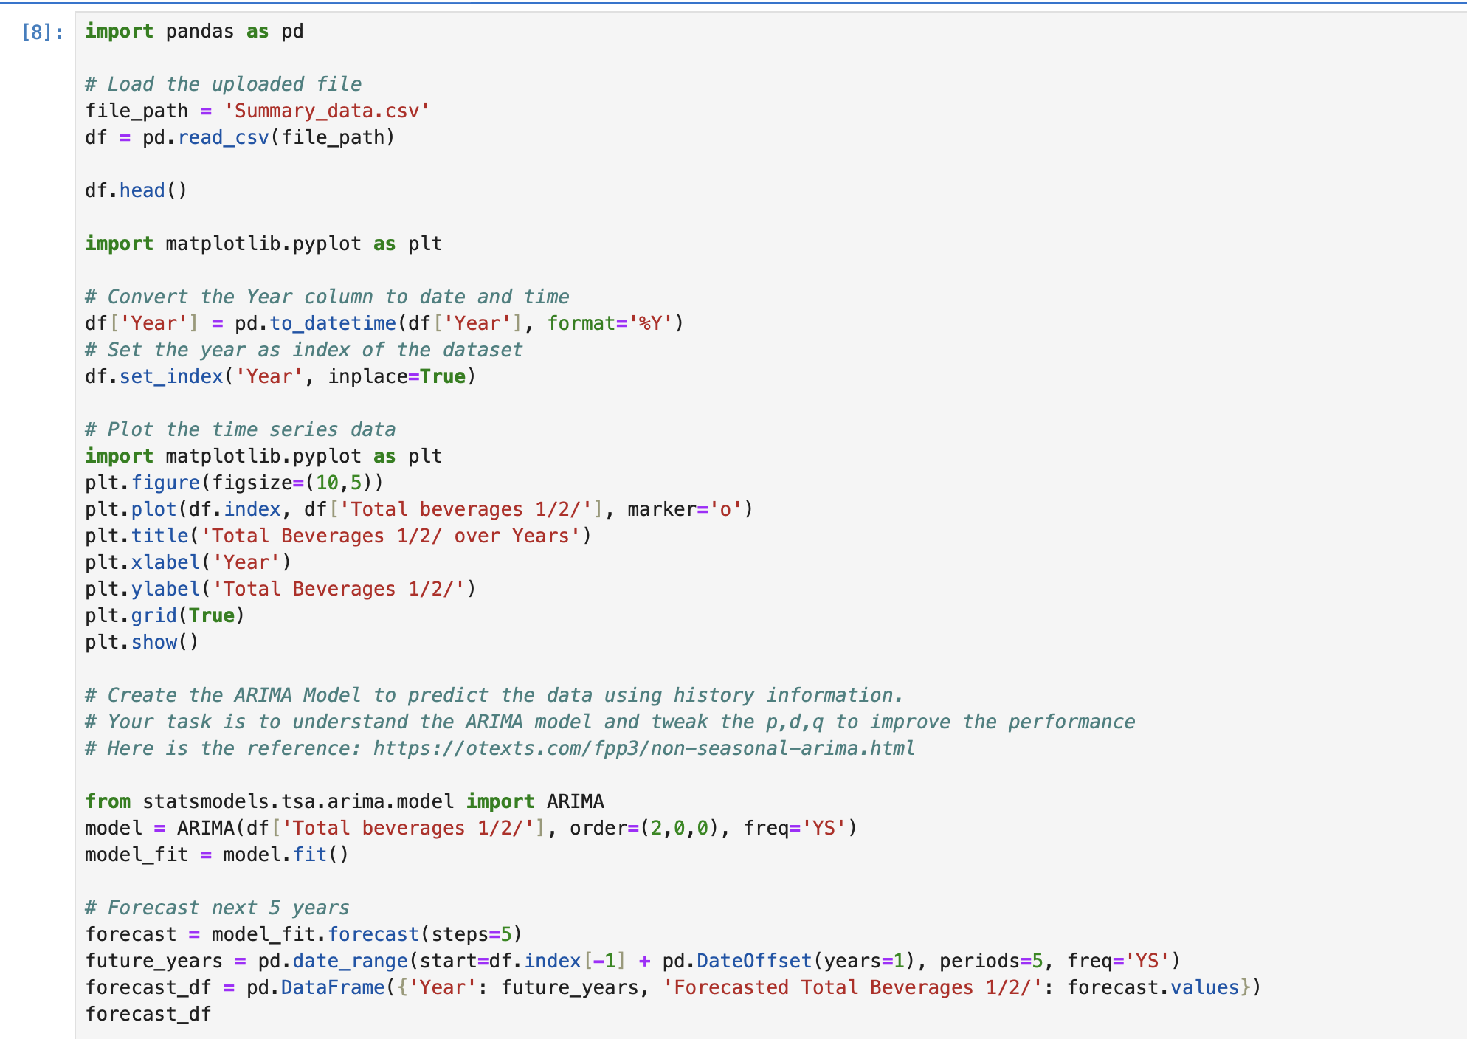
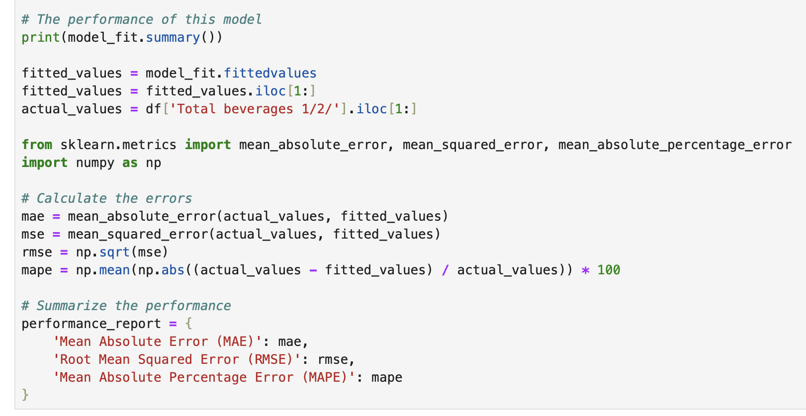
ARIMA Modeling Approach
Notes:
The second model we built was an ARIMA model, which is a time series forecasting model we used to evaluate and predict the future values for Total Beverage Import prices for the next five years based on the previous years’ Total Beverage Import Prices. So we are basically just predicting future values based on past values. ARIMA is the algorithm model used. AR(p) which stands for AutoRegressive is the number of lag observations in the model, also known as the lag order. The p is mainly what the team changed and tinkered with to try and find the best model. I (d) which stands for Integrated is the number of times the raw observations are different; also known as the degree of differencing. The MA(q) stands for the size of the moving average window, also known as the order of the moving average. We chose an ARIMA model because the model itself is good at forecasting based on past circumstances, which lines up directly with our project question and data available. However, past performance is not always an indicator of future performance and the model does a poor job of predicting turning points. ARIMA modeling is also usually an inadequate modeling method for long-term forecasting.
For the (ARIMA) model, the only cleaning we had to do was to convert the year column to date and time. We had to do this because ARIMA is a time series model so the data we’re using must be treated as such, and the order of observations affects the output of the model. In this model, similar to the MLR model, we did not have to handle any missing values or outliers. We also used the entire dataset to forecast five years into the future, therefore we did not need to train or test our data.

Slide 15

04
Results & Evaluation

Slide 16
MLR Model Evaluation: Statistical and Practical Value
Built an MLR model to forecast U.S. beverage import prices using:
  Year, U.S. Inflation, and Tariff Percent
Target Variable: Total beverage import price
Evaluated both statistical accuracy to see how well the model fits the data
Evaluated business relevance to see how useful the model is for real world decisions
Notes:
To evaluate our model, we focused on two main areas: statistical accuracy and business usefulness.
We built a multiple linear regression model to predict U.S. beverage import prices using three key predictors: year, U.S. inflation, and tariff percent. These were selected based on a correlation heatmap we created during our data exploration phase, which showed moderate to strong relationships between these variables and beverage prices.
Our target variable was the total beverage import price from 1999 to 2024, and our goal was to use this historical data to make informed forecasts for 2025.

Slide 17
Key Results
R² = 0.98 → Model explains 98% of price variation
P-Values: Not all predictors significant, but overall model strong
Residuals Analysis:
Histogram shows roughly normal distribution
Residual vs. predicted plot indicates mild heteroscedasticity
Q-Q plot confirms near-normal errors with a few outliers
Conclusion: Model is statistically valid with some limitations
Notes:
Our model achieved an R-squared value of 0.98, which means that 98% of the variation in beverage import prices can be explained by our three predictors. That’s a solid fit for this type of economic forecasting.
While the model overall was strong, the p-values showed that not all predictors were statistically significant at conventional levels — but they still contributed meaningful insight. We also reviewed confidence intervals and standard errors to understand the reliability of each coefficient.
We analyzed the model’s residuals — or prediction errors — using three visual tools:
• A histogram, which showed the residuals followed a roughly normal distribution.
this supports that our model is statistically valid, with just a few minor limitations when it comes to capturing extreme price movements.

Slide 18
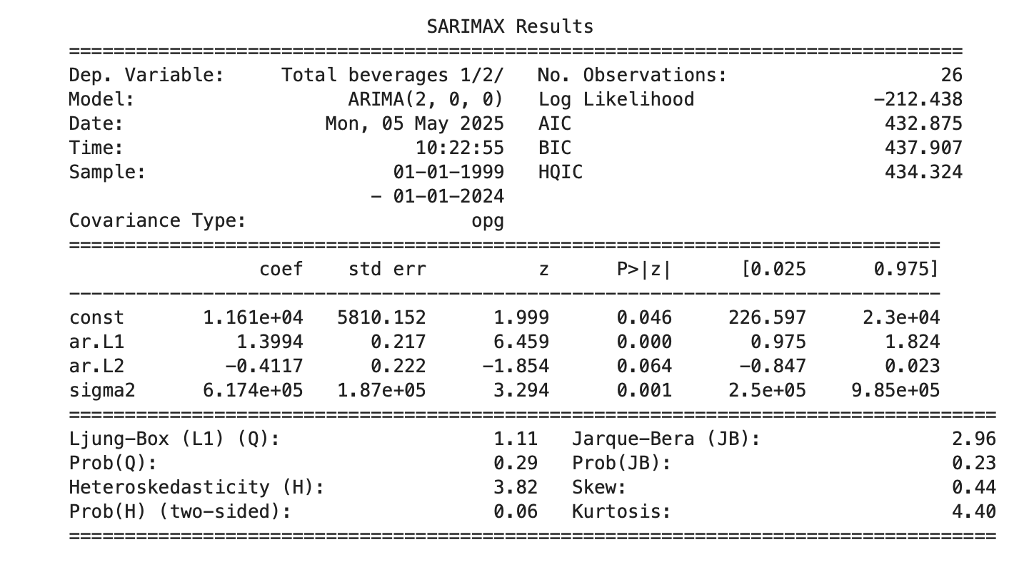
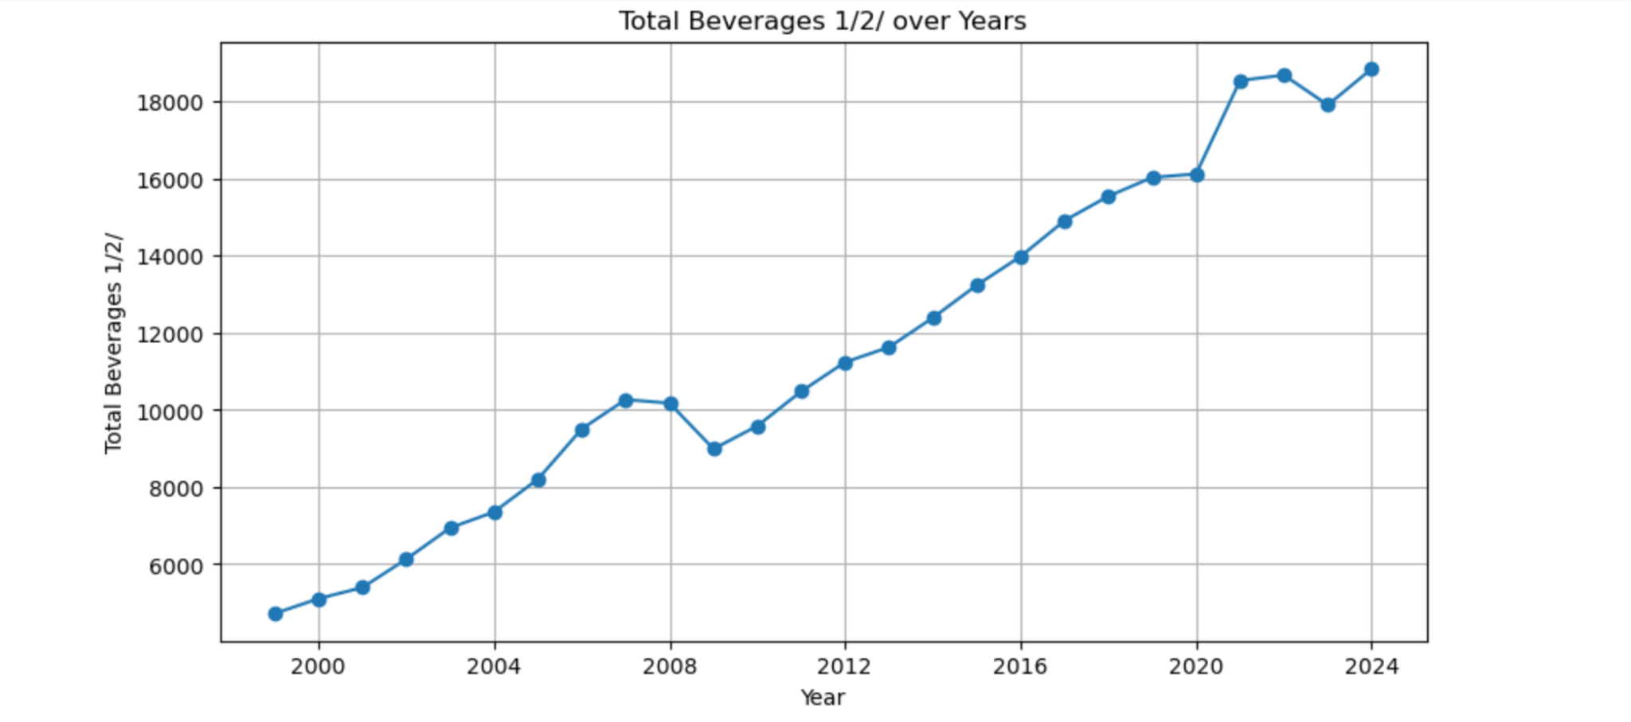
ARIMA Model Evaluation
The Akaike Information Criterion (AIC)
The Bayesian Information Criterion (BIC)
P - Values
Notes:
In the output for the ARIMA modeling technique, the team output a line chart titled “Total Beverages 1/2/ over Years,” to display how the data import prices will change collectively over time and into the future. We also utilized a SARIMAX Results table to better understand what was happening in the model. The Akaike Information Criterion (AIC) is what we looked at first because this metric quantifies both the goodness of fit of the model and the simplicity/parsimony of the model in a single statistic (Noble). The AIC when ARIMA is (2,0,0) is 432.875. The AIC when ARIMA is (1,0,0) is 435.432 which is higher than ARIMA (2,0,0). The Bayesian Information Criterion (BIC) is what we then looked at because this metric is a criterion for model selection among a finite set of models (Clement). The BIC when ARIMA is (2,0,0) is 437.097. The BIC when ARIMA is (1,0,0) is 439.207 which is higher than ARIMA (2,0,0). The lower AIC and BIC metrics are important in our decision to choose ARIMA (2,0,0) because lower values deem a better balance between fit and complexity.
Next, looking into the p-values in the SARIMAX chart, ar.L1 is statistically significant because the p-value is 0.0000 which is much lower than 0.05. Therefore, the first lag of Total Beverages is a strong predictor of the current value. Looking into the next metric, ar.L2 is technically not statistically significant because the p-value is 0.064 which is slightly higher than 0.05. However, the p-value is right on the threshold of being statistically significant so this value still does contribute meaningful variance explanation. This value likely captures additional lag effects which simulates what would happen in the real world. Although ARIMA (1,0,0) offered a simpler model, the team ultimately chose ARIMA (2,0,0) because of the higher AIC and BIC methods and the p-values.

Slide 19
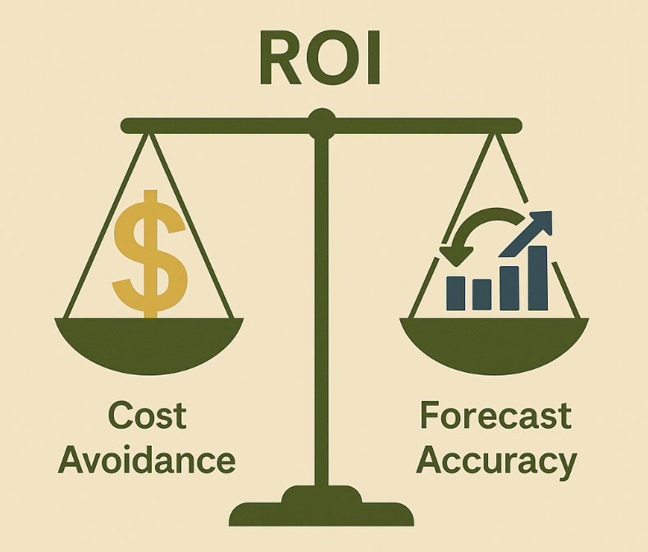
Business Case- Why the Model Matters?
Supports strategic planning, including:
Anticipating future price trends
Budgeting and forecasting
Supplier contract negotiation
Mitigating tariff-related risks
Adds value through cost avoidance, risk reduction, and supply chain resilience
Notes:
Even though we built a statistically strong model, we knew it was equally important to evaluate how this could actually be used in the real world.
Instead, it provides value through what we’d call a business case. This model can help importers, suppliers, and policy makers by:
• Anticipating future cost trends
• Improving budget planning and price forecasting
• Negotiating better supplier contracts
• And preparing for the financial impact of tariff or inflation changes
So, while we can’t calculate a specific dollar amount saved, this model offers clear strategic value. It’s a tool for smarter long-term planning, not just a short-term return.

Slide 20

05
Business Implications

Slide 21
Deployment: Implementation
Deployment Importance:
Critical for stakeholders in the U.S. beverage import industry
Includes distributors, supply chain managers, and policy analysts
Model Purpose:
Forecasts beverage import prices based on economic indicators (GDP, inflation, tariffs)
Helps businesses plan for future cost fluctuations
Deployment Platform:
Could be deployed as an interactive dashboard
Users can input current inflation rates, tariffs, and GDP data
Generates updated price forecasts for beverages

Slide 22
Tools and Platforms
Implementation in Business Environment:
Develop a user-friendly dashboard or API
Suggested Platforms:
Power BI or Tableau for the dashboard - Visualize forecasted trends in beverage import prices vs. actual values
Flask or Django for APIs - Integrate the model into existing enterprise systems
Functionality:
Enable real-time data updates
Provide automatic price forecasting

Slide 23

06
Conclusion

Slide 24
Ethical Concerns
Bias:
Ensure the model doesn’t favor certain beverage types or regions
Prevent biased pricing forecasts
Privacy:
Ensure business-specific data is anonymized and protected against unauthorized access
Fairness:
Ensure equal access to insights for all stakeholders, especially smaller importers/producers
Avoid creating unfair competitive advantages for larger players

Slide 25
Risk Mitigation Strategies
Refine the Model:
Incorporate additional variables (e.g., exchange rates, consumer demand, global trade patterns)
Provide a more comprehensive view of import price forecasting
Machine Learning Integration:
Move from linear regression to advanced models (e.g., random forests, gradient boosting)
Improve predictive accuracy, especially for non-linear relationships
Real-Time Data Integration:
Integrate real-time economic data (e.g., daily or monthly updates on inflation rates and tariffs)
Enhance model’s usefulness in dynamic market conditions

Slide 26
Maintenance and Monitoring
Model Maintenance & Monitoring:
Regular updates to ensure accuracy and relevance of predictions
Maintenance Actions:
Update model with new data (e.g., yearly updates of GDP, inflation, tariffs)
Reassess model performance annually by comparing forecasted vs. actual values - recalibrate the model if necessary
Automated alerts for stakeholders when large deviations are detected - prompt review of assumptions or model parameters

Slide 27

THANK YOU!

